Slide 1

Comparison of Search-based and Reinforcement Learning Agents in Solving the Game of Snake
SIDHARTHA GURIJALA

Slide 2
Project topic
The game is typically played using four arrow keys. The snake starts moving when the game is started, we need to guide the snake towards food by turning it to the left or right without colliding with borders or running into itself.
The food is randomly generated in the environment. Once the food is eaten by the snake its size increases.

Slide 3
Statement of project objectives
The primary objective of this project is to control the snake in a restricted environment. The snake needs to eat the food and on other hand it should avoid colliding with screen borders or even running into itself. As the snake eats the food it is increased in size.
The project main goal is to achieve the maximum score by collecting the food without snake colliding with walls or eventually running into itself.
Here we use Search-based and Reinforcement Learning Agents to compare their performances and achieving the optimal results.

Slide 4
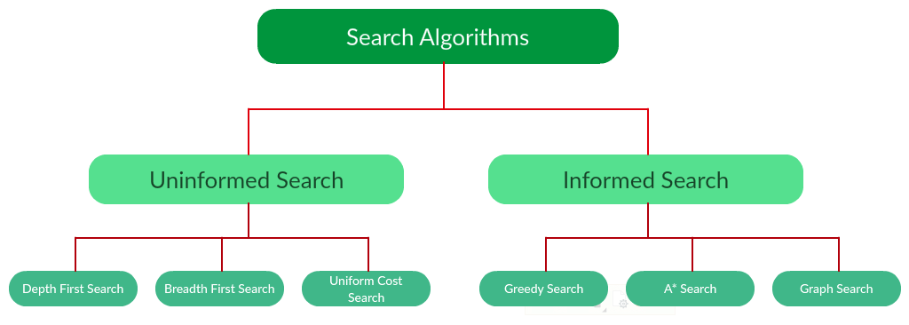
Search based Algorithm
A search problem consists of:
A State Space. Set of all possible states where you can be.
A Start State. The state from where the search begins.
A Goal Test. A function that looks at the current state returns whether or not it is the goal state.

Slide 5
Reinforcement Learning
Reinforcement learning is the training of machine learning models to make a sequence of decisions.
Reinforcement learning (RL) is an area of machine learning concerned with how software agents ought to take actions in an environment in order to maximize the notion of cumulative reward.
Main Points
Input: The input should be an initial state from which the model will start
Output: There are many possible output as there are variety of solution to a particular problem
Training: The training is based upon the input, The model will return a state and the user will decide to reward or punish the model based on its output.
The model keeps continues to learn.
The best solution is decided based on the maximum reward.

Slide 6
A* search Algorithm
A* is a graph traversal and path search algorithm, which is often used in computer science due to its completeness, optimality, and optimal efficiency.
The secret to its success is that it combines the pieces of information that Dijkstra’s Algorithm uses (favoring vertices that are close to the starting point) and information that Greedy Best-First-Search uses (favoring vertices that are close to the goal).
A* Search Algorithm is often used to find the shortest path from one point to another point. A* is often used for the common pathfinding problem in applications such as video games, but was originally designed as a general graph traversal algorithm.
One example of this is the very popular game- Warcraft III.

Slide 7
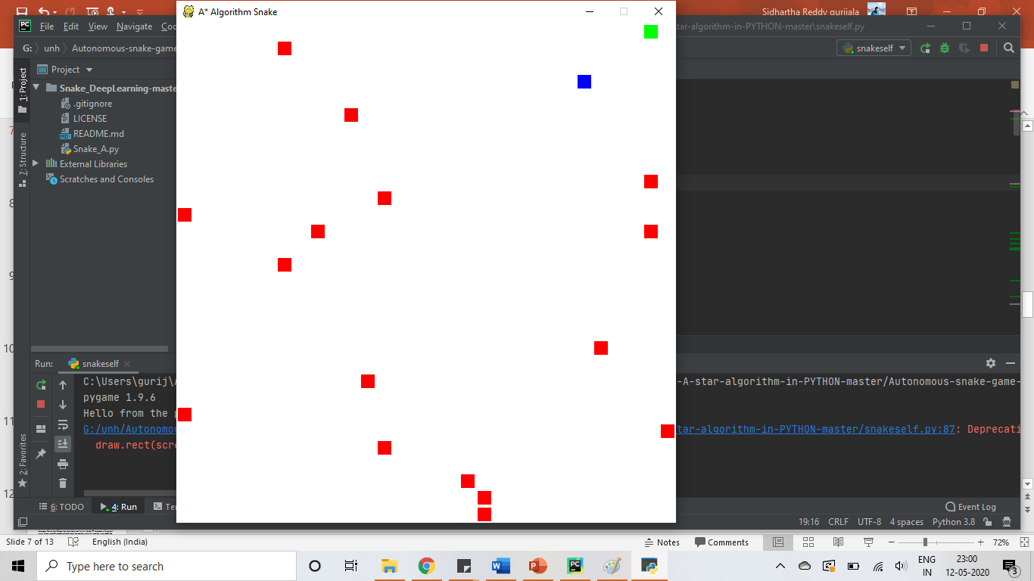
Screenshots

Slide 8
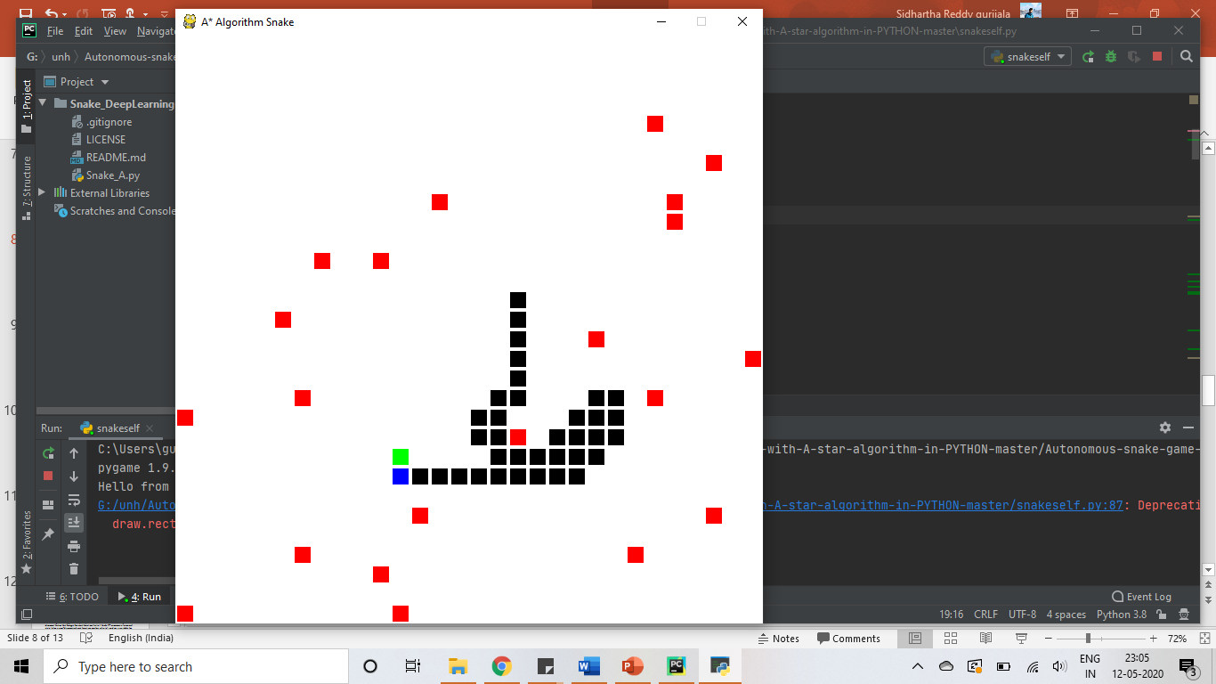
Screenshots

Slide 9
Q learning algorithm
Q-learning is a model-free reinforcement learning algorithm to learn a policy telling an agent what action to take under what circumstances.
Q-Learning is a value-based reinforcement learning algorithm which is used to find the optimal action-selection policy using a Q function.
Our goal is to maximize the value function Q.
The Q table helps us to find the best action for each state.
It helps to maximize the expected reward by selecting the best of all possible actions.

Slide 10
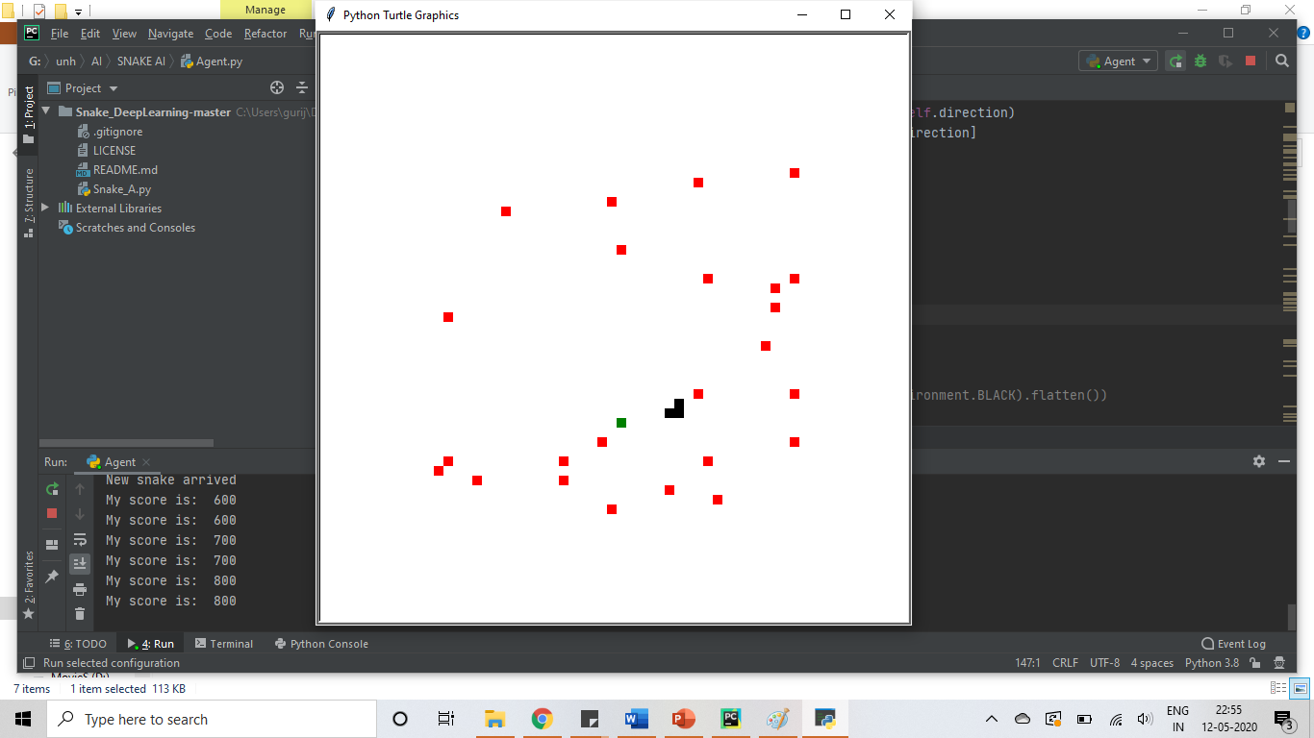
Screenshots

Slide 11
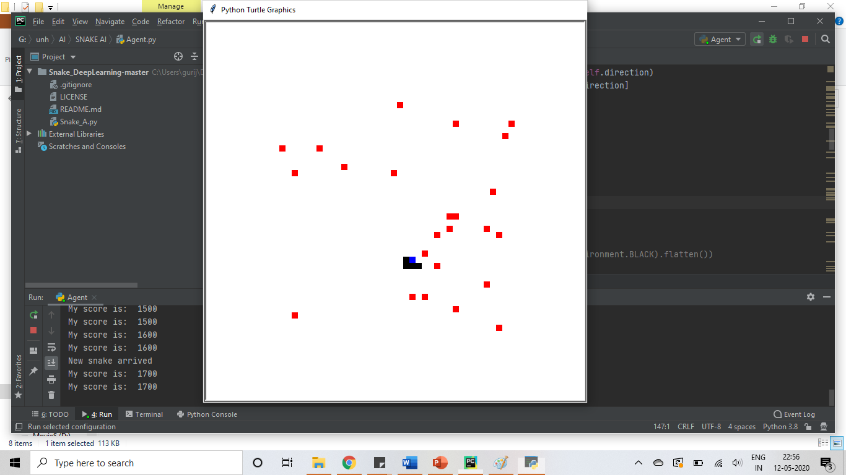
Screenshots

Slide 12
Difference between A* algorithm and Q learning algorithm
A* needs a model of transition probabilities between states, Q-learning can learn directly through experience without any prior knowledge of the problem.
A* needs an heuristic cost function, Q-learning only requires cost feedback implicitly from the environment.
A* is optimal in the number of backups. Q-learning, not so much.
A* is excellent at exploring the space. Q-learning, not so much.
Q-learning can be applied to cyclic (infinite maintenance) tasks through the use of discount factor that keeps the cost function finite. I think A* assumes a terminal state (else a non-discounted cost function my be infinite), and so is suitable for non-terminating processes.

Slide 13
References
https://www.researchgate.net/post/Reinforcement_learning_vs_heuristic_search
https://en.wikipedia.org/wiki/A*_search_algorithm
https://en.wikipedia.org/wiki/Q-learning
https://www.freecodecamp.org/news/an-introduction-to-q-learning-reinforcement-learning-14ac0b4493cc/

